Slide 1

COVID-19 IMPACT & FATIGUE
Texas Peace Officers are expected to follow the rules, regulations, policies and procedures of their respective departments.

Slide 2
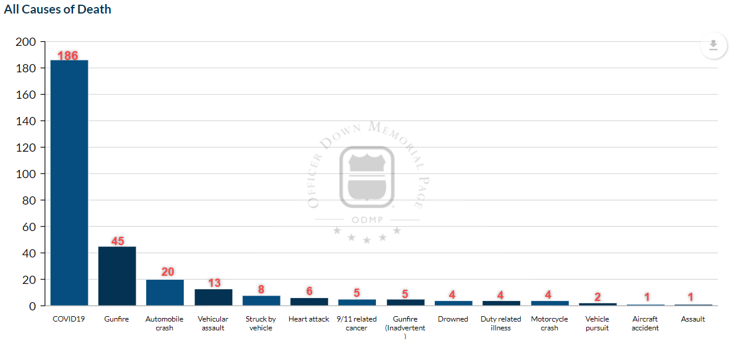
COVID-19 Hits Police
Source: Officer Down Memorial Page, 1/1/2020 -12/31/2020

Slide 3
COVID-19 IMPACT
According to ODMP, in 2020 Texas ranked first among the highest reported COVID-19 related deaths:
      Texas - 52
      Florida - 12
      Louisiana - 11
      California - 10
      New Jersey - 9

Slide 4
COVID-19 Prevention
Conduct daily temperature/symptom checks and take them seriously. Wash your hands frequently.
Your interactions with others will affect you and your family. Watch for symptoms of COVID-19 for yourself and those close to you.
Sanitize shared workspaces and items including computer keyboards, ticket writers, BWC’s, etc.
Sanitize your patrol vehicle regularly, especially if using a shared fleet.
Do not hesitate to talk about it and communicate any concerns.

Slide 5
COVID-19 Prevention
If possible, place caution indicators/flags for any address that has a known virus exposure through Dispatch. Ensure these flags are removed once an isolation period has expired, however continue to treat as a high risk for exposure.
When possible, ask involved parties if they have signs/symptoms and/or to step outside to minimize time spent in people’s homes. Keep social distancing as tactics allow.
Death investigations have a lower risk of exposure than active citizen interactions, but PPE is still mandatory. Do not assist with body lifts if possible, and limit number of officers inside.

Slide 6
COVID-19 Response
Avoid unnecessary close (i.e., within 6 feet) or physical (i.e., touching) contact with members of the general public and especially those who are experiencing signs and/or symptoms consistent with COVID-19.
Perform as many tasks as possible in areas away from individuals. Treat all contacts as potential COVID-19 exposures.

Slide 7
COVID-19 Response
It is a best practice to wear your mask. Consider the quality and layers of your mask.
If you use single use masks, dispose of them accordingly and if you have a reusable mask, clean it frequently.

Slide 8
COVID-19 Response
Keep a complete change of clothes/uniform at the duty station, in case the clothes being worn become contaminated and need to be bagged for cleaning/disinfection. Avoid shaking the clothes. Follow standard operating procedures for laundering contaminated work clothing.
Avoid touching your face, including eyes, nose, and mouth (the ‘T’ Zone), particularly until after you have thoroughly washed your hands upon completing work and/or removing PPE.

Slide 9
COVID-19 Response
Quarantine if a family member has symptoms.
Underlying health conditions can be life-threatening. Use extreme vigilance.
Quarantine or test when traveling for vacation.

Slide 10
The Battle is Far From Over
COVID-19 is a threat to all officers.
Fatigue with protective measures is not an excuse for not protecting yourself.
The virus is still spreading.
The vaccine will not make this go away overnight, especially if personnel choose not to vaccinate.
First responders must continue to be vigilant at work and home.

Slide 11
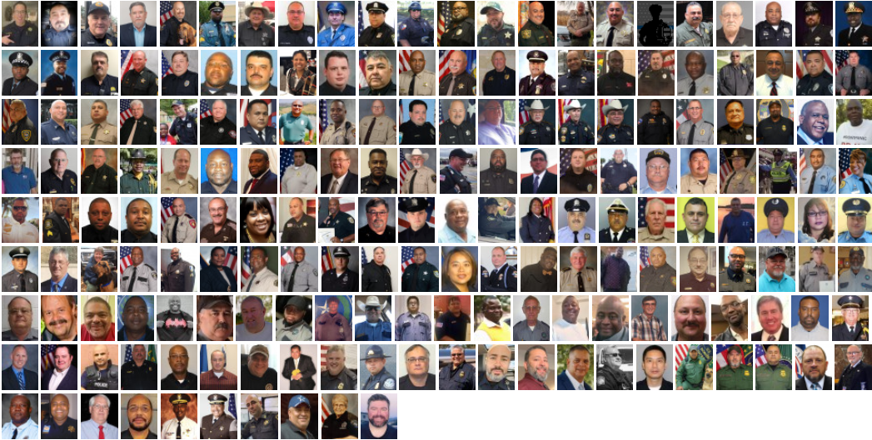
2020
186 COVID-19 Related Deaths

Slide 12
Additional COVID-19
Guidance & Resources
www.cdc.gov/coronavirus/2019-ncov/community/guidance-law-enforcement.html
www.osha.gov/SLTC/covid-19/emergency-response.html
https://bit.ly/TMLIRPCovid19
(Suggested Hierarchy of Controls for COVID 19)
TML Risk Pool members have access to no-cost COVID-19 for Law Enforcement online course. Sign-in page and info for online course: www.localgovu.com/tmlirp/ or email losspreventiontraining@tmlirp.org

Slide 13

5 Cornerstones

